Slide 1
Childhood Acute Lymphoblastic Leukemia
Kelsey Shaffer
CHTN
Staff Meeting Presentation

Slide 2
What is it?
Acute Lymphoblastic Leukemia (ALL) is a blood cancer
White Blood Cells (WBC)
  Lymphocytes or Lymphoblast
  Too many immature WBC
    Crowd the bone marrow
    Cannot prevent/fight infections
Most common leukemia in children, least common in adults

Slide 3
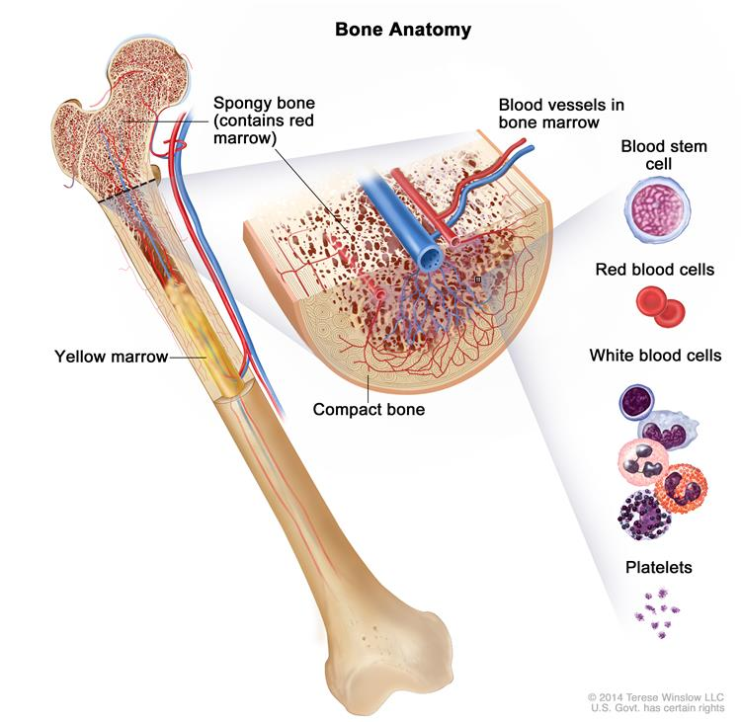
Anatomy of the Bone

Slide 4
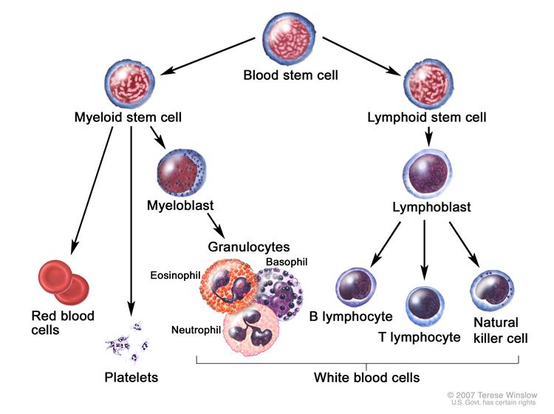
Normal Blood Stem Cell Division

Slide 5
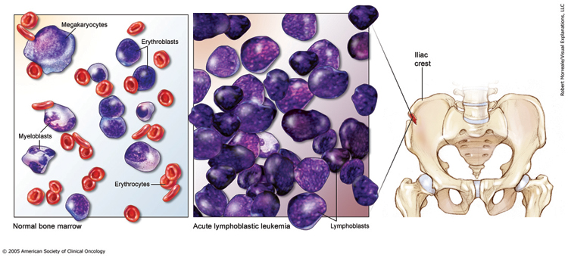

Slide 6
Types
There are two groups of ALL
  B Cell ALL
    85% of ALL patients
    Mature B Cell ALL
      Burkitt Leukemia
  T Cell ALL
Subtype | Frequency
Early Pre-B cell | 60-65%
Pre-B Cell | 20-25%
Mature B Cell | 2-3%
T Cell | 15-18%

Slide 7
Signs and Symptoms
Fatigue or weakness
Pale Skin
Anemia: Lightheaded, short of breath
Frequent infections
Fevers
Easy bleeding or bruising
Bone or joint pain
Swelling of the abdomen, face or arms
Loss of appetite, weight loss
Swollen lymph nodes
Coughing or trouble breathing
Headache
Seizures
Vomiting

Slide 8
Exams, Testing, & Diagnosis
Physical exam and history
Complete blood count
Blood chemistry studies
Bone Marrow aspiration and biopsy
  Cytogenetic analysis
  Immunophenotyping
Lumbar puncture
Chest X-ray
Testicular biopsy

Slide 9
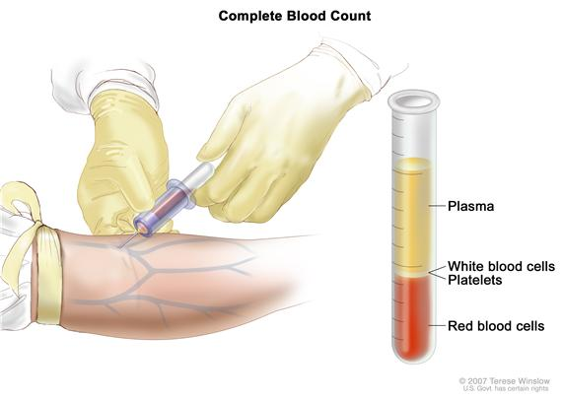
Complete Blood Count

Slide 10
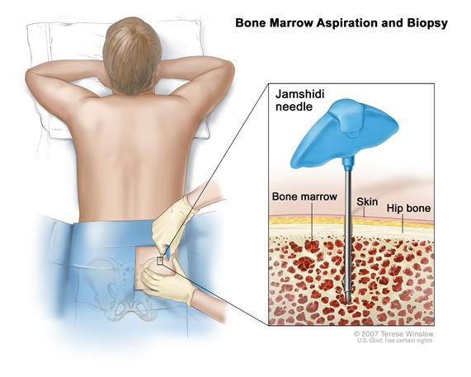
Bone Marrow Aspiration

Slide 11
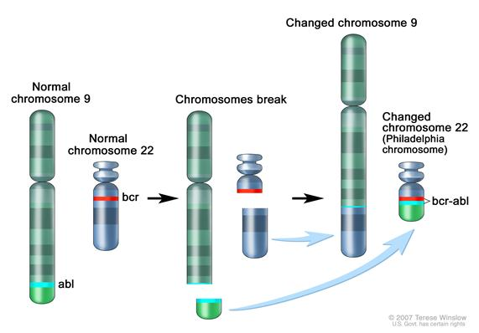
Philadelphia Chromosome

Slide 12
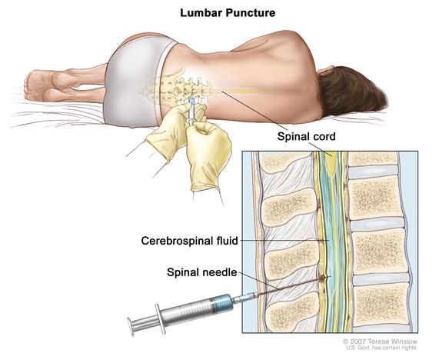
Lumbar Puncture

Slide 13
Staging and Classification
Not normal Staging and Grading system
  No Tumor!!
Classified by:
  Age
  WBC Counts
  Immunophenotyping: B Cell or T Cell
  Genetic abnormalities in the leukemia cells
  Response to early treatment

Slide 14
NCI Risk Groups
Standard (low) risk
  Children from the ages of 1-10
  WBC count of less than 50,000/μL at diagnosis
High Risk
  Children older than 10
  WBC count of 50,000/μL or higher at diagnosis

Slide 15
Risk Groups: Other Factors
B lymphocytes or T lymphocytes?
Are there chromosome or gene changes?
How quickly does the leukemia cell count drop after treatment?
Are there leukemia cells in the cerebrospinal fluid at diagnosis?

Slide 16
COG Risk Groups: B Cell
 | Low Risk | Average Risk |  | High Risk |  |  | Very High Risk
NCI Risk (Age/WBC) | SR | SR | SR | SR | SR | HR | SR | HR | HR | Any
Favorable Genetics | Yes | Yes | No | Yes | No | Any | No | Any | Any | Any
Unfavorable Characteristics | No | No | No | No | No | No | No | No | No | Yes
Day 8 PB MRD (%) | <0.01 | ≥0.01 | <1 | Any | ≥1 | Any | Any | Any | Any | Any
Day 29 Marrow MRD (%) | <0.01 | <0.01 | <0.01 | ≥0.01 | <0.01 | <0.01 | ≥0.01 | ≥0.01 | <0.01 | Any
% of Patients Estimated | 15 | 36 |  | 25 |  |  | 24
Anticipated 5-year EFS | >95% | 90-95% |  | 88-90% |  |  | <80%

Slide 17
COG Risk Group: T Cell
Low Risk
  NCI: SR
  CNS1 and no testicular disease
  M1 marrow
  MRD <0.1% on day 29
Intermediate Risk
  Does not meet criteria for Low risk
  M1 Marrow with MRD <1% on day 29
  Any CNS
High Risk
  M2 marrow
  MRD ≥1% on day 29
  Any CNS

Slide 18
Treatment
Three phases:
  Remission induction
  Consolidation/ intensification
  Maintenance

Slide 19
Treatment Types
Chemotherapy
Radiation
Chemotherapy and a stem cell transplant
  Mostly relapsed patients
Targeted Therapy
  TKIs

Slide 20
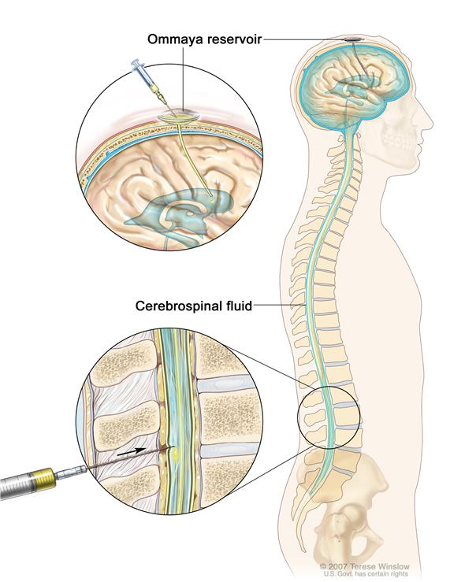
Treatments
If the leukemia has spread to the cerebrospinal fluid
  This is used in addition to regular treatment

Slide 21
Vanderbilt Clinical Trials
COGAALL0932
  Opened 11/11/10
  Standard risk Pre-B ALL
  Maintenance phase of treatment
  Oral methotrexate: 40mg/m2/week vs 20mg/m2/week
  Reduced-pulses Maintenance with vincristine/dexamethasone: Every 12 weeks vs every 4 weeks
  Estimated Enrollment: 5872

Slide 22
Follow ups
Done during all phases of treatment
  Bone marrow aspirations and Biopsy
Yearly physical exams
Based on treatment type:
  Neurocognitive testing at baseline if cranial radiation was done
  Testing for heart function at baseline then every 3-5 years
  Testing for baseline lung function, then every 3-5years
  Creatinine taken at baseline then every 3-5 years
  Yearly monitoring for evidence of Fanconi syndrome
  Liver function tests every 1-3 years
Annual CBCs

Slide 23
Risk Factors
X-ray exposure before birth
Radiation exposure
Chemotherapy
Genetic conditions
  Down Syndrome
  Neurofibromatosis Type 1 (NF1)
  Shwachman syndrome
  Bloom syndrome
  Ataxia-telaniectasia

Slide 24
Survival Rates
5-year survival rate is over 85%
More than 95% attain remission
Differences seen by
  Age
  Gender
  Race

Slide 25
References
http://www.cancer.org/cancer/leukemiainchildren/detailedguide/childhood-leukemia-what-is-childhood-leukemia
http://www.cancer.gov/cancertopics/pdq/treatment/childALL/Patient/
http://www.vicc.org/ct/protocols.php?cancer-type=Pediatric-Leukemia
http://www.cancer.org/cancer/leukemiainchildren/detailedguide/
http://www.cancer.net/cancer-types/leukemia-acute-lymphoblastic-all-childhood/medical-illustrations
http://www.cancer.net/cancer-types/leukemia-acute-lymphoblastic-all-childhood/classification
http://www.webmd.com/cancer/acute-lymphoblastic-leukemia
http://www.stjude.org/all
http://www.cancercenter.com/leukemia/types/tab/acute-lymphocytic-leukemia/?source=GOOGLPPC&channel=paid%20search&c=paid%20search:Google:Non%20Brand:Broad:acute+lymphoblastic+leukemia:Broad&OVMTC=Broad&site=&creative=41239722201&OVKEY=acute%20lymphoblastic%20leukemia&url_id=190216663&adpos=1t1&device=c&gclid=CMv-wr-RyMACFSgV7AodOBIAxQ
http://www.leukaemia.org.au/blood-cancers/leukaemias/acute-lymphoblastic-leukaemia-all
http://www.vicc.org/ct/protocols.php?cancer-type=Pediatric-Leukemia
http://www.lls.org/diseaseinformation/managingyourcancer/survivorship/childhoodcancersurvivors/followupcare/
http://www.chop.edu/service/oncology/cancers-explained/leukemia-diagnosis-and-treatment.html

