Slide 1


CHTN Staff Meeting
Neuroblastoma
Alle Crider

Slide 2
Neuroblastoma
Neuroblastoma
  Develops from immature nerve cells
  Most commonly in and around the adrenal glands
  Can also develop
    In other areas of the abdomen
    Chest, neck, & near the spine (where groups of nerve cells exist)
    Horner Syndrome
  Most commonly affects children age 5 or younger
  Sporadic vs. Familial
    Somatic mutations = Sporadic neuroblastoma
    Familial - Gene mutations that increase the risk of developing cancer can be inherited from a parent
      Mutations in the ALK and PHOX2B genes
        Anaplastic Lymphoma Kinase
        Nerve cells
http://ghr.nlm.nih.gov/condition/neuroblastoma
  http://www.mayoclinic.org/diseases-conditions/neuroblastoma/basics/definition/con-20027487.

Slide 3
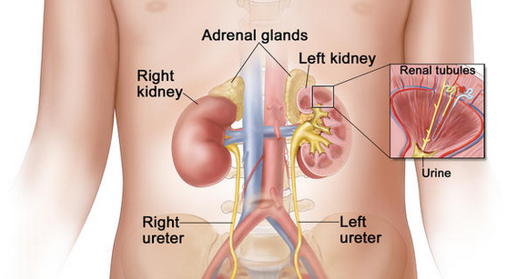
Neuroblastoma

Slide 4
Neuroblastoma
Neuroblastoma
  Most common extracranial solid tumor in childhood
  More than 650 cases are diagnosed each year in North America
  Prevalence is about 1 case per 7,000 live births
  Incidence is about 10.54 cases per 1 million per year in children younger than 15 years
  About 37% are diagnosed as infants, and 90% are younger than 5 years at diagnosis, with a median age at diagnosis of 19 months
http://emedicine.medscape.com/article/988284-overview

Slide 5
Survival by:
Risk Group and Age
The 5-year survival by risk group:
  Low-risk group: Higher than 95%
  Intermediate-risk group: 90%-95%
  High-risk group: 40%-50%
The 5-year survival stratified by age:
  Younger than 1 year – 90%
  1 to 4 years – 68%
  5 to 9 years – 52%
  10 to 14 years – 66%
  http://www.cancer.gov/cancertopics/pdq/treatment/neuroblastoma/HealthProfessional/page1
  http://www.cancer.org/cancer/neuroblastoma/detailedguide/neuroblastoma-survival-rates

Slide 6
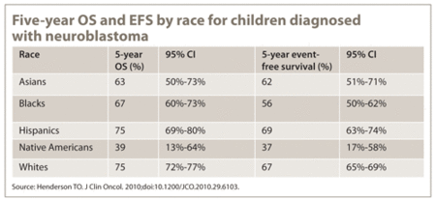
Survival by: Race
http://www.healio.com/hematology-oncology/news/print/hemonc-today/%7Be59a2ba2-4050-41bc-9656-d3e8b24d889c%7D/blacks-native-americans-more-likely-to-have-high-risk-neuroblastoma-poorer-survival

Slide 7
Staging
INSS
  a postoperative staging system that was developed in 1988 (in an effort to combine two previously used staging systems) and used the extent of surgical resection to stage patients
INRGSS
  a preoperative staging system that was developed specifically for the INRG classification system.
  http://www.cancer.gov/cancertopics/pdq/treatment/neuroblastoma/HealthProfessional/page3.

Slide 8
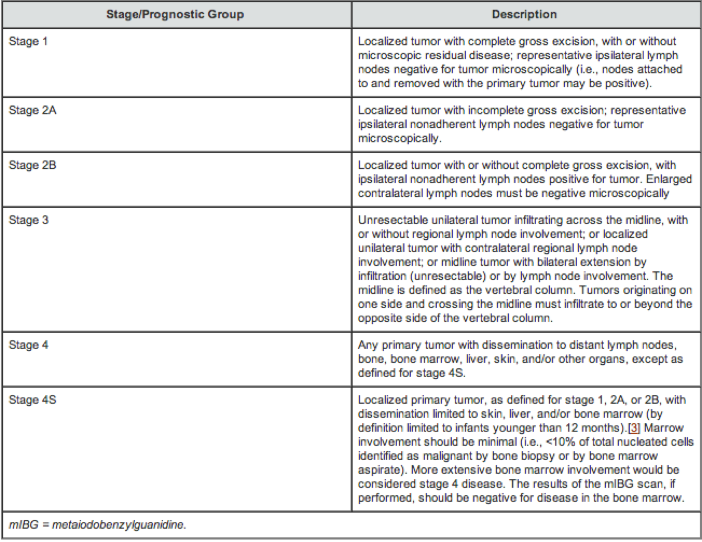
Staging INSS

Slide 9
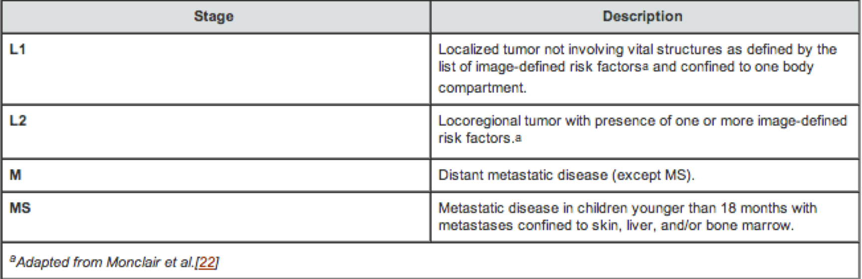
Staging INRGSS
Each patient has a risk stage defined that predicts outcome and dictates the appropriate treatment approach to be followed
Predictive value for lower stage patients, with stage L1 having a 5-year EFS (event free survival) of 90%, compared with 78% for L2

Slide 10
Treatments
Standard Treatments
  Observation
  Surgery
  Radiation
  Chemotherapy/drugs
  High-dose chemo and radiation therapy with stem cell rescue
http://www.vicc.org/cancers/disease-info.php?xml=xml-files/summary/CDR258023.xml&target=treatment#

Slide 11
Treatments: Radiation
External Beam Radiation
  Usually directed at the tumor, but total body radiation is used as well
MIBG radiotherapy
  Used to treat some patients with advanced Neuroblastoma
http://www.cncfhope.org/Neuroblastoma_Radiation_Therapy

Slide 12
Treatments: Chemotherapy
Combinations are common
Examples of main drugs used
  Cyclophosphamide/ifosfamide
    Alkylating agent
  Cisplatin/carboplatin
    Platinum-compound that acts as an alkylating agent
  Vincristine
    Vinca alkaloid
  Doxorubicin (Adriamycin)
    Anthracycline antibiotic
  Etoposide
    Derived from a type of plant alkaloid called podophyllotoxin
  Topotecan
    Type of plant alkaloid known as a topoisomerase I inhibitor
http://www.cancer.org/treatment/treatmentsandsideeffects/guidetocancerdrugs/busulfan

Slide 13
Treatments: Retinoid Therapy
Retinoids – Chemicals that are related to Vitamin A
  Differentiating agents – thought to help some cancer cells differentiate into normal cells
  Isotretinoin – reduces risk of recurance after high-dose chemo and stem cell transplant

Slide 14
Treatments:
High-Dose Chemo/Radiation Therapy with Stem Cell Transplant
Used in children with high-risk Neuroblastoma
  Harvesting child’s own stem-cells
  High-dose chemo and/or radiation
  Peripheral blood stem cell transplant
http://www.cncfhope.org/Neuroblastoma_High-Dose_Chemotherapy-Radiation_Therapy_and_Stem_Cell_Transplant

Slide 15
Treatments
Low Risk
  Surgery followed by observation
  Chemo with or without surgery
Intermediate Risk
  Chemo with or without surgery
  Surgery alone for infants
  Observation alone for infants
  Radiation therapy for tumors that are causing major problems or that are not responding to other therapies
High Risk
  Regimen of combination therapy, surgery, stem cell rescue, radiation, and chemotherapy
  Clinical trials

Slide 16
Literature
2008 – MIBG for the Treatment of Neuroblastoma
  Two things increase the uptake of MIBG into Neuroblastoma cells:
    Pretreatment with Cisplatin or doxorubicin
    Pretreatment with ϒ-interferon and retinoic acid
http://www.ncbi.nlm.nih.gov/pmc/articles/PMC2633223/

Slide 17
Clinical Trial
Objective: to provide palliative therapy with MIBG for patients with advanced neuroblastoma, pheochromocytoma, or paraganglioma, and gain more information about acute and late toxicity of 131I-MIBG therapy for patients with refractory neuroblastoma, pheochromocytoma, or paraganglioma
Patients: 12 months or older
  Enrollment not listed
Principal Investigator: Haydar Frangoul
Drugs:131-MIBG/Iobenguane Sulfate
http://www.vicc.org/ct/protocol-results.php?protocol-no=VICCPED1249.

Slide 18
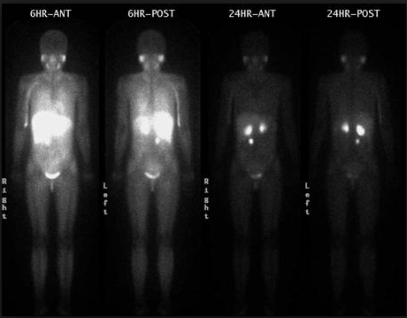
MIBG
MIBG: combined with radioactive iodine (I 123, I 131) to form a radioactive compound
  I 123 MIBG
    Has a shorter half-life than I 131 MIBG
    Preferred for scans because of lower radiation dose, better quality images, less thyroid toxicity, and lower cost
http://www.drugs.com/pro/iobenguane-sulfate-i-131.html
http://www.cancer.gov/clinicaltrials/search/view?cdrid=682134&version=HealthProfessional.

Slide 19
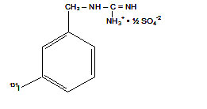
MIBG
I 131 MIBG
  Iobenguane sulfate I 131, I 131-meta-iodobenzylguanidine sulfate
  Similar in structure to the anti-hypertensive drug guanethidine and neurotransmitter norepinephrine
  http://www.mayoclinic.org/drugs-supplements/iobenguane-i-131-intravenous-route/description/drg-20064357.

Slide 20
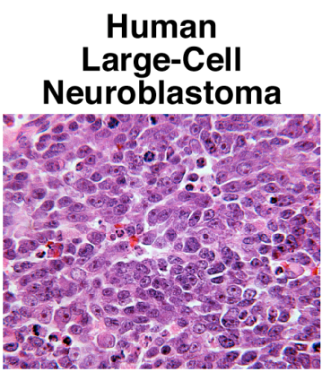
MIBG
I 131 MIBG
  Taken up by neuroblastoma or pheochromocytoma tumor cells and delivers radiation specifically to the cancer cells and causes them to die
  http://www.mayoclinic.org/drugs-supplements/iobenguane-i-131-intravenous-route/description/drg-20064357.

Slide 21
MIBG
Side effects
  Most of the radiation stays in the area of the neuroblastoma, so most children do not have serious side effects from this treatment
  Nausea, vomiting and sleepiness have been reported after injection of higher than the recommended doses of Iobenguane sulfate I 131
  Some children might have swollen cheeks because it can affect the salivary glands and in rare cases it may cause high blood pressure for a short period of time
  http://www.cancer.gov/clinicaltrials/search/view?cdrid=682134&version=HealthProfessional.

Slide 22
Sources
http://ghr.nlm.nih.gov/condition/neuroblastoma
  http://www.mayoclinic.org/diseases-conditions/neuroblastoma/basics/definition/con-20027487.
  http://emedicine.medscape.com/article/988284-overview
  http://www.cancer.gov/cancertopics/pdq/treatment/neuroblastoma/HealthProfessional/page1
  http://www.cancer.gov/cancertopics/pdq/treatment/neuroblastoma/HealthProfessional/page3
  http://www.vicc.org/cancers/disease-info.php?xml=xml-files/summary/CDR258023.xml&target=treatment#
http://www.cancer.gov/drugdictionary?CdrID=38860
http://www.cancer.gov/drugdictionary?CdrID=39748
http://www.cancer.gov/drugdictionary?CdrID=42251
http://www.vicc.org/ct/protocol-results.php?protocol-no=VICCPED1249
http://www.drugs.com/pro/iobenguane-sulfate-i-131.html
http://www.cancer.gov/clinicaltrials/search/view?cdrid=682134&version=HealthProfessional
  http://www.mayoclinic.org/drugs-supplements/iobenguane-i-131-intravenous-route/description/drg-20064357
  http://www.cancer.gov/clinicaltrials/search/view?cdrid=682134&version=HealthProfessional

Slide 23
