Slide 1
Pediatric Brain Tumors
By: Aunshka Collins

Slide 2
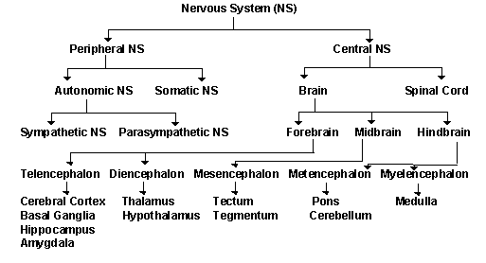
What is the nervous system?

Slide 3
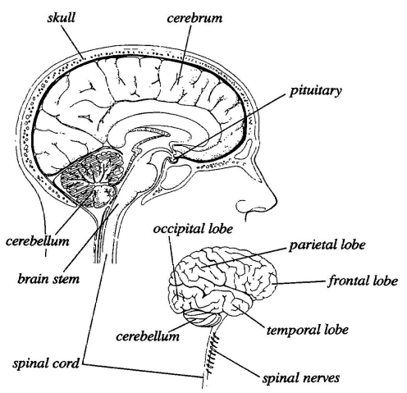
Central Nervous System (CNS)
Brain
  Control center
  Movement, speech,
  memory, emotion,
  thoughts
  Interpretation of
  sensory information
  (i.e., taste, vision,
  hearing, touch)

Slide 4
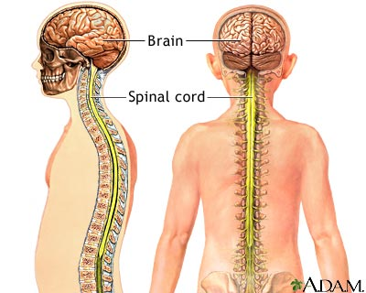
Central Nervous System (CNS)
Spinal Cord
  Main pathway for information connecting the brain and the peripheral nervous system

Slide 5
Overview of Pediatric
Brain Tumors
Abnormal growths or masses that occur in the brain tissue
Most common solid tumor in children
  Under the age of 15
  Represent about 20% childhood cancers
Treatment and chance of recovery (i.e., prognosis) depends on the tumor:
      Type
      Location within the brain
      Whether it has infiltrated other brain tissue
      Child’s age and health

Slide 6
Symptomology
Increased head size in infants
Seizures
Morning headache or headache that goes away after vomiting
Unusual sleepiness
Alterations in vision, hearing and speech
Frequent nausea
Personality changes

Slide 7
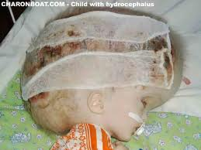
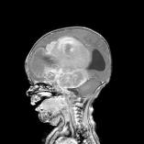
Hydrocephalus
Leads to swelling of the brain

Slide 8
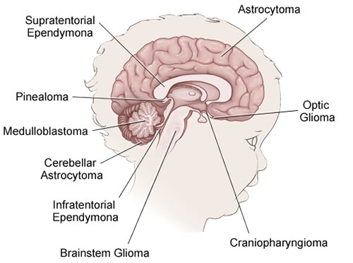
Types of Pediatric Tumors
The most common types of brain tumors in children are gliomas and medulloblastomas

Slide 9
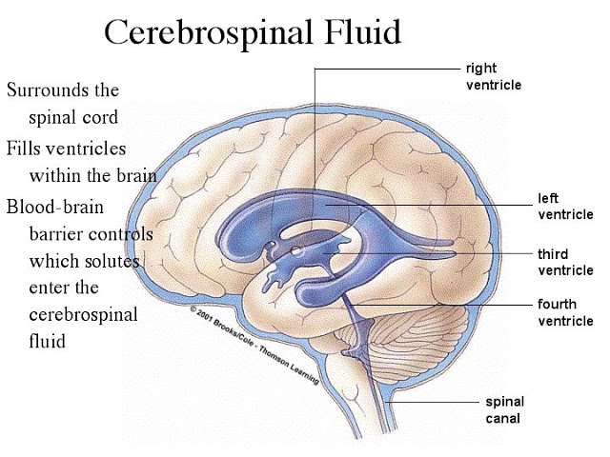
Something to Remember
Pediatric CNS tumors are not staged
      They do not metastasize, except via cerebrospinal fluid (CSF)
      Therefore, spinal imaging is required in certain tumors (e.g. medulloblastoma)
      How serious a brain tumor is in a child depends on its grade

Slide 10
Pediatric Grading
Grade I and II (low-grade):The tumor grows slowly
  Rarely infiltrates into nearby tissues.
  Grade II can infiltrate into nearby tissues
  Can be cured by surgery
Grade III and IV (high-grade): The tumor grows quickly
  Likely to infiltrate into nearby tissue
  Grade IV tumors usually cannot be cured/removed by surgery

Slide 11
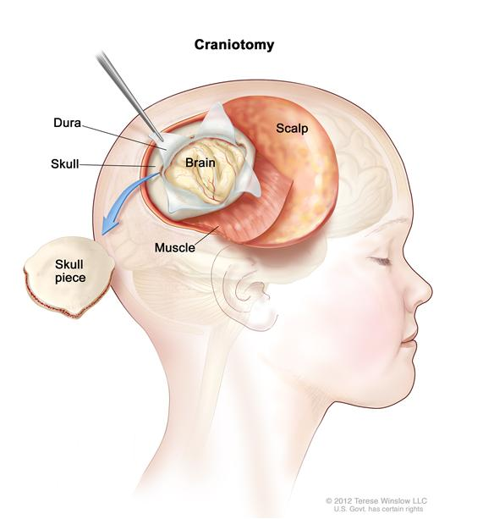
Astrocytoma
Originate in a particular glia cell, astrocytes
Most common type of glioma
There are four primary types:
  Juvenile pilocytic astrocytoma (Grade I)
    Usually cystic (fluid-filled) and develops in the cerebellum
    Surgical removal is often the only treatment necessary
  Fibrillary astrocytoma (Grade II)
    Infiltrates into the surrounding normal brain tissue
    Difficult to remove by surgery difficult
  Anaplastic astrocytoma (Grade III)
  Glioblastoma multiforme (Grade IV)
    This is the most malignant type of astrocytoma
    Grows rapidly, increasing pressure in the brain

Slide 12
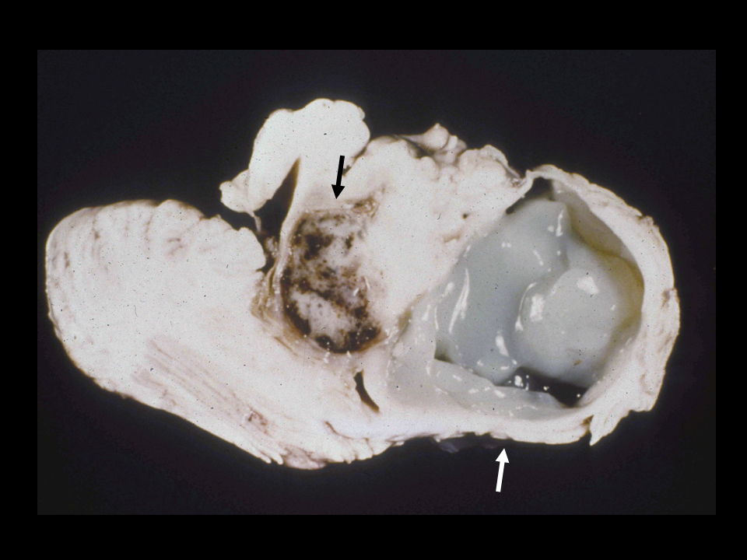
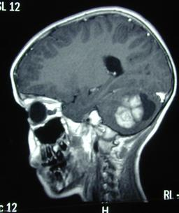
Juvenile Pilocytic astrocytoma

Slide 13
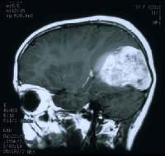
Glioblastoma Multiforme

Slide 14
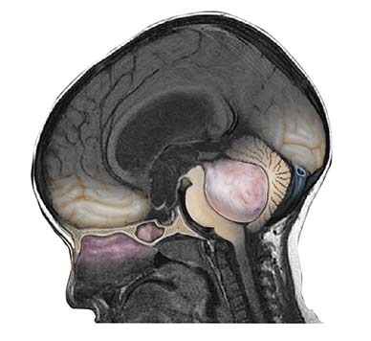
Medulloblastoma
Accounts for 15% of brain tumors in children
Form in the cerebellum
Referred to as a infratentorial primitive neuroectodermal tumor (PNET)
Can metastasize to the spinal
cord
    Highly aggressive

Slide 15
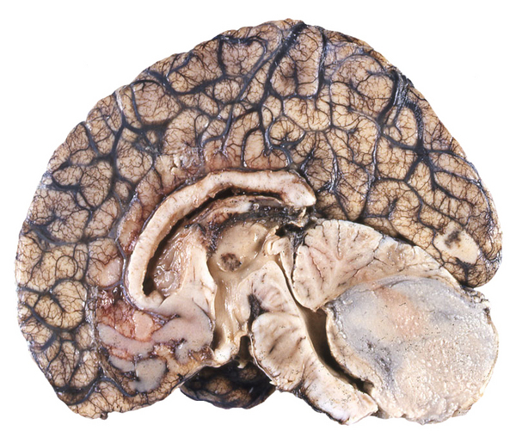
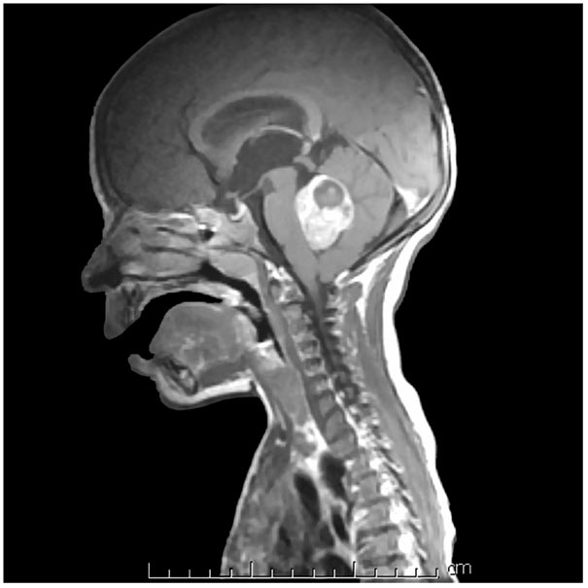
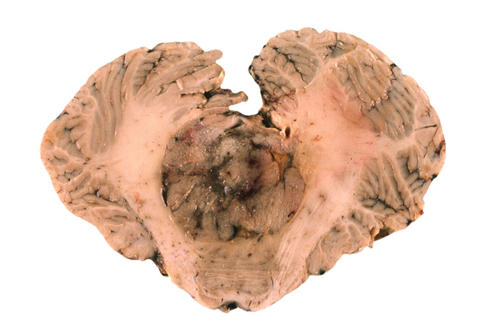
Medulloblastoma
4-year-old, presenting with morning vomiting

Slide 16
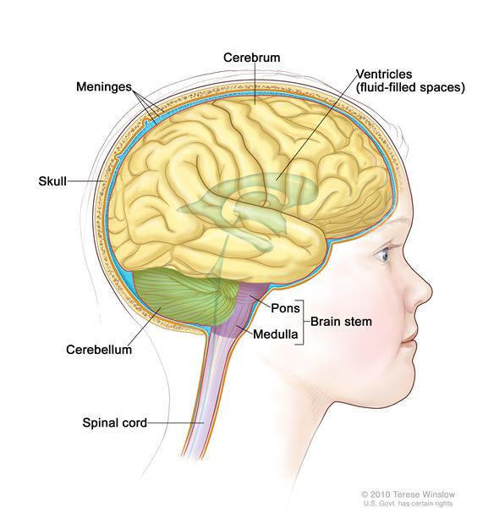
Brainstem Glioma
  Located in the middle of the
  brainstem
  Majority of the tumors cannot be
  surgically removed
  Occur in school-aged children
  Symptoms include:
    Endocrine problems
    Paralysis of nerves/ muscles of the
    face
    Respiratory changes

Slide 17
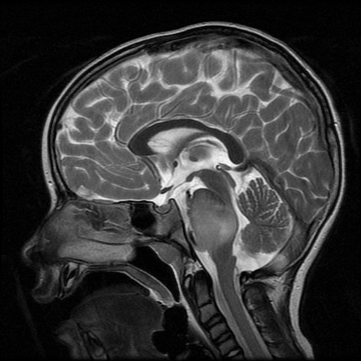
Brainstem Glioma

Slide 18
Statistics
The American Cancer Society estimates that brain and spinal cord tumors are the second most common cancers in children (after leukemia).
  1 out of 4 childhood cancers
More than 4,000 (CNS) tumors are diagnosed each year in children and teens.
Boys develop these tumors slightly more often than girls.
About 3 out of 4 children with brain tumors (all types combined) survive at least 5 years after being diagnosed.
About 1,310 children younger than 15 years old are expected to die from cancer in 2013.

Slide 19
References
http://www.nlm.nih.gov/medlineplus/childhoodbraintumors.html
http://www.mayoclinic.org/pediatric-brain-tumors/
http://www.abta.org/pediatric-adolescent/your-childs-brain-tumor.html
http://pediatricneurosurgery.org/diagnosis/brain-tumors
http://www.brainline.org/content/2012/07/can-the-brain-itself-feel-pain.html
http://www.oapublishinglondon.com/article/340
http://www.charonboat.com/item/12
http://www.hopkinsmedicine.org/neurology_neurosurgery/specialty_areas/brain_tumor/center/pediatric/tumors/
http://www.patient.co.uk/doctor/Brain-Tumours-in-Children.htm
http://laccsvivistadasam.blogspot.com/2013/05/fluido-spinale-cerebrale-ha-quattro.html
http://www.cancer.gov/cancertopics/pdq/treatment/child-astrocytomas/patient/page1/AllPages
http://www.urmc.rochester.edu/libraries/courses/neuroslides/lab2b/slide067.cfm
http://www.mypacs.net/cases/JUVENILE-PILOCYTIC-ASTROCYTOMA-560716.html
http://220.128.112.10/ftp/3649/misc/940715/eMedicine%20-%20Astrocytoma%20%20Article%20by%20Tobey%20MacDonald,%20MD.htm
http://www.braintumor.org/patients-family-friends/about-brain-tumors/tumor-types/primitive-neuroectodermal.html
http://www.nature.com/nrclinonc/journal/v4/n5/fig_tab/ncponc0794_F1.html
http://www.pubcan.org/printicdotopo.php?id=41
http://www.mayoclinic.org/medicalprofs/enlargeimage5586.html
http://www.britannica.com/EBchecked/topic/77391/brainstem/
http://www.uptodate.com/contents/diffuse-pontine-glioma
http://radiopaedia.org/images/628501
http://www.cancer.org/cancer/cancerinchildren/detailedguide/cancer-in-children-key-statistics
http://faculty.washington.edu/chudler/nsdivide.html
http://faculty.washington.edu/chudler/spinal.html
http://www.healthcentral.com/chronic-pain/h/spinal-cord-nervous-system.html

