Slide 1

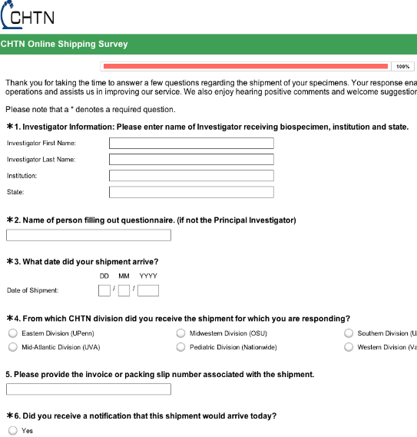
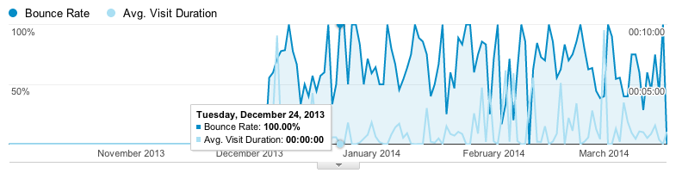
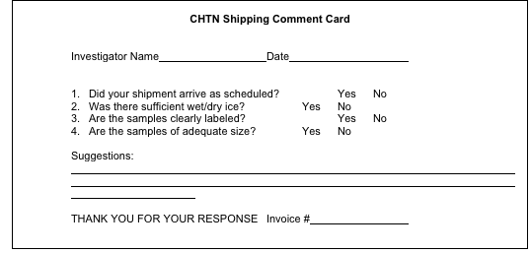
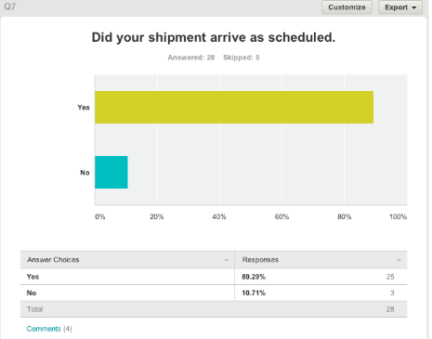
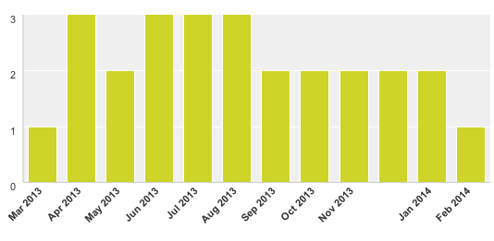
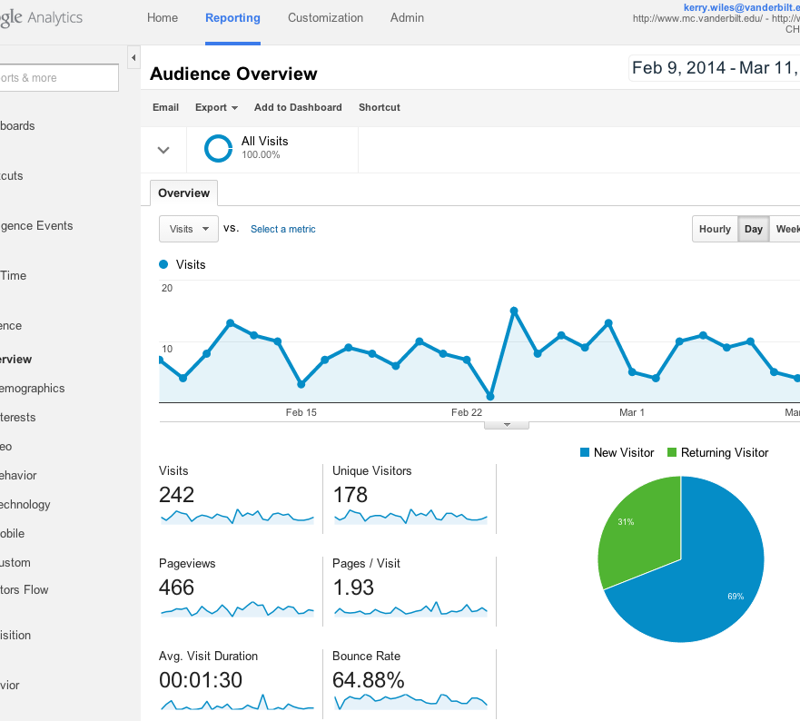
Transforming Business Operations
of an Academic Biorepository
through the
Utilization of Measurable KPIs
#122
By: Kiley Wease, Nicole Bollinger, Kerry Wiles and Mary Kay Washington M.D., Ph.D.
Department of Pathology, Microbiology and Immunology – Vanderbilt University Medical Center
Introduction
Implementation cont.
The Cooperative Human Tissue Network at Vanderbilt University Medical Center (CHTN-VUMC) is a federally funded service oriented grant that provides high-quality biospecimens and services to the research community. CHTN-VUMC has implemented measureable business specific Key Performance Indicators (KPIs) as an essential part of operations. The varying KPIs were extracted and tracked through specific business intelligence (BI) applications. CHTN-VUMC established a plan of action to standardize and increase customer feedback, ease website navigation and better establish marketing endeavors using the data pulled from the BI applications. Each of these processes is essential in ensuring that our enterprise is aligned with our goals and provides a model for continuously achieving higher standards of business operations.
CHTN-VUMC utilizes SurveyMonkeyTM as the main point of contact for customer feedback on shipments received. SurveyMonkeyTM is an online survey software that simplifies the exportation of data and reports. Each Investigator receives the link to the feedback survey (see Example 3) on their shipment email and is asked to complete after each shipment. The purpose of this survey is to streamline and improve CHTN-VUMC’s shipping processes and eliminate any errors. The biggest challenge for CHTN-VUMC has been getting Investigators to continue filling out the survey each time they receive a shipment. The data obtained from these survey responses is essential for maintaining the TQM of CHTN-VUMC’s enterprise.
Background
Example 3
As an academic biorepository, the resources and funds can be limiting to an organization, so the analytics extracted from BI applications become extremely important to operations. CHTN-VUMC uses KPIs as dynamic markers to measure and achieve goals that directly affect business operations. By definition, a KPI is a set of quantifiable measures that a company or industry uses to gauge or compare performance in terms of meeting their strategic and operational goals. The CHTN-VUMC specific KPIs have increased and changed throughout the years to keep with relevant and beneficial operations. The implementation of BI applications, specifically Google AnalyticsTM and SurveyMonkeyTM, was a recent addition to the business operations of CHTN-VUMC.
CHTN-VUMC has relied on limited marketing endeavors and customer feedback to try and continuously advance operations and meet investigator demands. The main methods of marketing by CHTN-VUMC have been administering marketing booths at conferences, supplying researchers with “CHTN” gear, social media (Facebook, Twitter), and word of mouth or networking. Marketing can be expensive and fast-paced for any enterprise, but particularly difficult for the academic biorepository whose main directive is to serve a large number of investigators quickly with specimens and data. Understanding and developing a set of KPIs may be one way that an academic biorepository can determine if strategies are working properly and efficiently. Customer feedback has come a long way from the initial and unreliable paper surveys (see Example 1) and has entered the digital realm, which has allowed for large sets of data to be generated and mined.
The collaborative advantage that the CHTN-VUMC has is its’ six divisions ability to collect, analyze and share data from a single national website and as individual divisions, forging alliances to pursue systematic innovation. CHTN-VUMC works to standardize and increase investigator feedback for the benefit of Total Quality Management (TQM) and SOP revisions.
Results
The monthly extraction of CHTN-VUMC’s Google AnalyticsTM exploited an awareness that the website was not functioning efficiently and navigation was poor. The CHTN-VUMC analyzed Google AnalyticsTM bounce rate, pageviews, unique pageviews, avg. time on page, entrances and % exit received from October 2013. CHTN-VUMC collaborated to determine the KPIs most beneficial for the business enterprise. A consensus was made to decrease the Bounce Rate (% of visitors that go to one page then exit) and increase the Average Visit Duration (average amount of time visitor is on the site).
The re-organization of the CHTN-VUMC website occurred in November 2013 and data tracked until March 2013 (see Chart A). The re-organization consisted of; rewording section titles, aesthetics, adding personnel contact information under each picture, adding an RSS feed, and editing/adding additional video tutorials. The future direction is the addition of an RSS feed to the CHTN-VUMC website to create an easy and frugal gateway for marketing endeavors to expand, while simultaneously increasing the Average Visit Duration of the website. For example, weekly updates on the advances of Science can lead to a new focus in Investigators’ research and lead them to entering new requests for specimens from CHTN-VUMC.
Chart A
Conclusion
Example 1
As an academic biorepository, CHTN-VUMC relies on the standardization and frequency of customer feedback, while collaborating with other divisions to share data. In past years, feedback from shipping surveys has been low and inconsistent but necessary for the success of CHTN-VUMC’s business enterprise. As a method to standardize across all CHTN divisions, an important and vital decision was made to begin utilizing SurveyMonkeyTM as the primary application for recording, analyzing and sharing Investigator feedback. CHTN-VUMC can develop KPIs using the feedback entered in to SurveyMonkeyTM by Investigators to perform better business practices; such as updating operational SOPs and handling Investigator complaints in a timely manner (see Charts B and C). For example, an Investigator may need less dry ice in their shipment or need to change other shipping parameters to reduce waste.
Implementation
CHTN-VUMC focuses the development of business KPIs on the utilization of BI applications because the research and success of these applications has already been established. CHTN-VUMC created a website through SiteBuilder, which is a pre-formatted website builder managed by the Vanderbilt University Information Technology (VUIT) department. CHTN-VUMC monitors and edits the website through SiteBuilder, and also extracts active analytics. VUIT has an established account with Google AnalyticsTM for all the VUMC websites that utilize SiteBuilder. At the end of every month, two PDFs of analytics are provided to CHTN-VUMC with the results from the previous month. This information was not sufficient enough for CHTN-VUMC, so an individual Google account was set-up through VUIT to monitor website analytics more frequently. See Example 2.
Chart C
Chart B
Example 2
Conclusion
CHTN-VUMC utilizes BI applications to extract valuable data from KPIs for website re-organization, innovative marketing endeavors and the standardization of customer feedback. The use of SurveyMonkeyTM and Google AnalyticsTM can transform CHTN-VUMC into a digitally successful business enterprise that maintains high quality specimens and customer satisfaction. The relevant KPIs extracted from BI applications can eventually reach a desirably efficient position, while continuing to develop and move CHTN-VUMC forward as an established academic biorepository.
Acknowledgements
We thank the CHTN-VUMC staff for their continued efforts and support: Erik Brooks, Robert Burnell, Lane Clemons, Aunshka Collins, Brittney Fain, Regina Jenkins, Grace Ordung, Stephanie Shelton and Linda Sircy. This project is supported by NCI/NIH 2U01CA091664-10.

