Slide 1
Bladder Cancer
Ishan Parikh

Slide 2
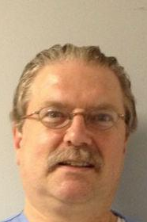
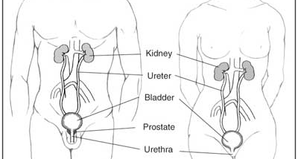
Where and What?
The bladder…
-stores urine received from the kidneys
-is about the size of a pear when empty
-is a very elastic organ
-has a normal capacity of approximately 400-600mL

Slide 3
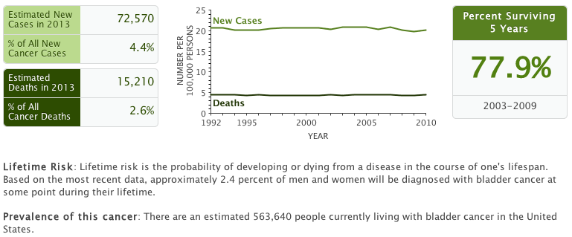
Facts and Statistics

Slide 4
Facts and Statistics
4th most common in males, not common for females
4x higher likelihood in males than females, 2x for Caucasian male than African American male

Slide 5


Risk Factors
Smoking is the number 1 risk factor
  All the carcinogens sit in bladder until excreted
  4x more likely than nonsmoker
  Estimated to cause about half of all cases in men and women
  Men tend to smoke more
Workers in the dye, rubber, leather, and aluminum industries, painters, and people who live in communities with high levels of arsenic in the drinking water also have an increased risk.

Slide 6
Symptoms and Detection
Symptoms –
  Most common symptom is blood in urine
  Increased frequency or urgency of urination
  Irritation during urination
Detection –
  No current early detection method
  Microscopic examination of cells from urine
  View bladder wall with a cystoscopy
  Other detection methods – tumor markers, body scans
    Further research is needed
    Body scans mostly look for metastasis

Slide 7
Histology
90-95% Transitional-Cell Carcinoma
3% Squamous-Cell Carcinoma
2% Adenocarcinoma
<1% Small-Cell Carcinoma

Slide 8
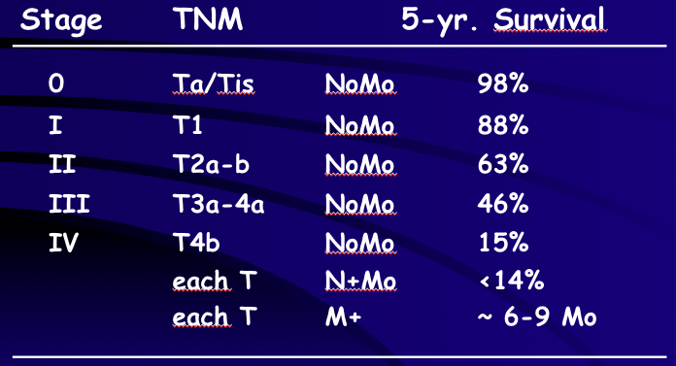
Staging

Slide 9
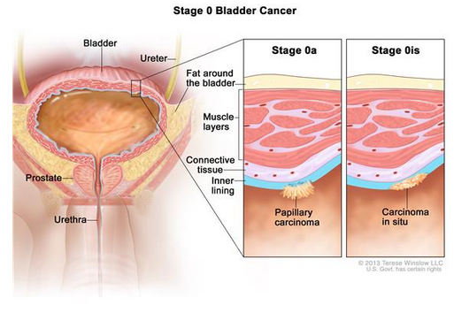
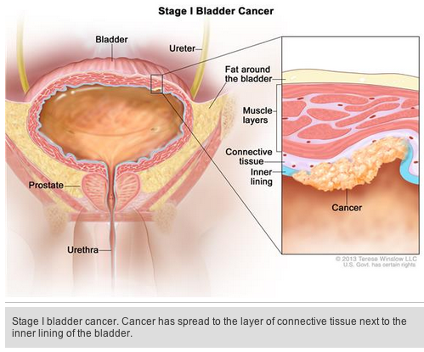
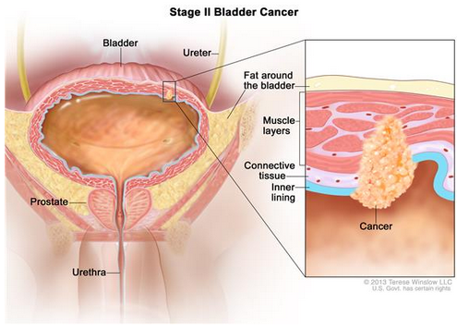
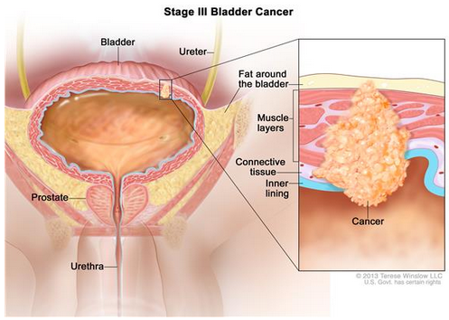
Staging

Slide 10
Treatments
Vary by stage
TUR (Transurethral Resection)
Radical Cystectomy (major side effects)
Radiation
Intravesical Therapies
  BCG (bring in immune system)
  Interferon (stimulate immune system)
  Intravesical chemotherapy

Slide 11
Discussion Items
TUR patients have high rate of return cancer
Bladder is easy to research
Less than 5% of contents go into systemic circulation
Clinical trials – regenerated bladder in 26 canines
Clinical trials – testing new tumor markers

Slide 12
Most popular in TN?

Slide 13
