Slide 1
Cancer Registries and Classifications
How are cancer statistics kept up to date?

Slide 2
Cancer Reporting
Example:
Dx stage II colon cancer - 2007
Cancer has metastasized to the liver – 2009
How does the hospital and clinician stage patient?
Answer:
All staging is done at time of diagnosis, before any treatment
Initial staging never changes
New cancer is Stage II colon cancer with liver metastasis

Slide 3
Why have registries?
Look for trends over time
Find cancer patterns in groups of people
Show whether prevention measures are making a difference
Show regional based statistics

Slide 4
Cancer Registries
There are many local, state, and national cancer registries
Hospital registry – local
Population-based registries - state
National level
CDC’s National Program of Cancer Registries (NPCR)
NCI’s Surveillance, Epidemiology, and End Results (SEER) Program
National Cancer Data Base (NCDB)

Slide 5
State and Local Registries
Local helps hospitals improve and uncover geographic patterns
State registries use population-based information from:
Hospitals, doctor’s offices, nursing homes, pathology laboratories, ambulatory care facilities, radiation and chemotherapy centers, and other cancer care facilities
Helps to see trends regionally

Slide 6
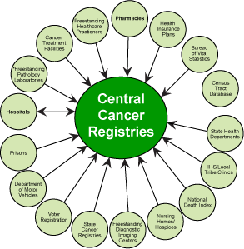
National Program of Cancer Registries
Established by the Cancer Registries Amendment Act in 1992.
Registries staff is highly trained
Highest level is Certified Tumor Registrar (CTR)

Slide 7
National Program of Cancer Registries
Before NPCR - some states had registries, but lacked resources
Had no legislative support
No way to gather complete data
After NPCR – central cancer registries
More funding
Smoother communication
Better results

Slide 8
Surveillance, Epidemiology and End Results
Part of National Cancer Institute
Collects on 28% of US population
Help in reporting
Number of new cases
Survival
Prevalence (how many people with cancer in certain time period)

Slide 9
NPCR + SEER – Collect it all!
Type
Gender
Age
Race
Stage
Notes:
Like incidence ( new cancer cases ) and mortality ( deaths ) across regions of the country. Cancer rates in types of jobs or see whether survival is improving

Slide 10
National Cancer Data Base
Established 1989 by Commission on Cancer(COC) and American Cancer Society
Main purpose is to ensure quality care by collecting data for
Evaluating hospitals
Comparing cancer cares between institutions
Setting standards to help improve quality
More than 1400 centers and 26 million hospital cancer records

Slide 11
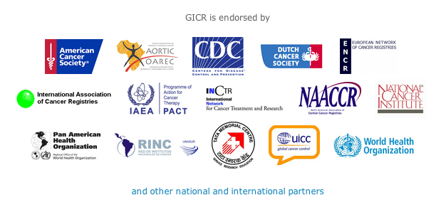
Global Registries
Global Initiative for Cancer Registry
Launched November 2011
Helps gain information from low- and middle-income countries
Still in building stages with many partners

Slide 12
References
Centers for Disease Control and Prevention. National Program of Cancer Registries (NPCR). Accessed at www.cdc.gov/cancer/npcr/
Commission on Cancer. About the CoC. National Cancer Data Base (NCDB). Accessed at ww.facs.org/cancer/ncdb/index.html
National Cancer Institute. Surveillance, Epidemiology and End Results. Accessed at http://seer.cancer.gov/index.html
National Cancer Institute. Surveillance, Epidemiology and End Results. SEER training modules: Cancer Registration. Accessed at http://training.seer.cancer.gov/registration/
International Agency for Research on Cancer. Accessed at http://gicr.iarc.fr/en/whoweare.php

