Slide 1
Pancreatic cancer
By Linda Sircy

Slide 2
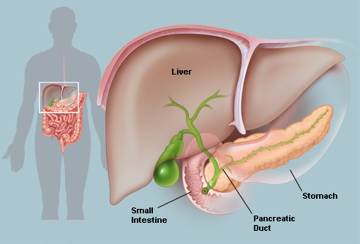
Where is the pancreas?
Between the stomach and spine
Lies partially behind the stomach and rests in the curve of the small intestine
http://www.webmd.com/digestive-disorders/picture-of-the-pancreas

Slide 3
Statistics
The ACS estimates:
  About 45,220 people (22,740 men and 22,480 women) will be diagnosed with pancreatic cancer
  About 38,460 people (19,480 men and 18,980 women) will die of pancreatic cancer
  Rates of pancreatic cancer have been slowly increasing over the past 10 years
  The lifetime risk of developing pancreatic cancer is about 1 in 78.

Slide 4
Exocrine tumors
Most common type
  Benign cysts and benign tumors (cystadenomas) can occur,
  but most are malignant.
About 95% are adenocarcinomas
Less common types include:
  Adenosquamous carcinomas
  Squamous cell carcinomas
  Signet ring cell carcinomas
  Undifferentiated carcinomas
  Undifferentiated carcinomas with giant cells
  Solid pseudopapillary neoplasms of the pancreas
  Ampullary cancer (or carcinoma of the ampulla of Vater)

Slide 5
Endocrine tumors
Known as pancreatic neuroendocrine tumors (NETs),
  or islet cell tumors
Subtypes include:
  Insulinomas**
  Gastrinomas**
  Glucagonomas
  Somatostatinomas
  VIPomas (Vasoactive Intestinal Peptide)
  Ppomas (Pancreatic Polypeptide)
  Carcinoid tumors

Slide 6
Risk factors
Age
Gender
Race
Tobacco use
Obesity
Diabetes
Chronic pancreatitis
Cirrhosis of the liver
Occupational exposure
Stomach problems
Diet
Coffee
Alcohol

Slide 7
Risk factors
Family history/Genetic syndromes
  Inherited gene mutations may cause as many as 10% of pancreatic cancers:
    Hereditary breast and ovarian cancer syndrome
    Familial melanoma
    Familial pancreatitis
    Hereditary non-polyposis colorectal cancer (HNPCC), also known as Lynch syndrome.
    Peutz-Jeghers syndrome (PJS), also linked with polyps in the digestive tract and several other cancers
    Von Hippel-Lindau syndrome
    Pancreatic neuroendocrine tumors and cancers can also be caused by a genetic syndrome, such as: Neurofibromatosis type 1 and Multiple endocrine neoplasia type 1

Slide 8
Signs and symptoms
Exocrine tumors
  Jaundice
  Darkening urine
  Abdominal or back pain
  Weight loss and poor appetite
  Digestive problems
  Gallbladder enlargement
  Blood cots or fatty tissue abnormalities
  Diabetes
Endocrine tumors
  Stomach ulcers, abdominal pain, nausea
  Decreased appetite, weight loss, malnutrition, digestion problems
  Diabetes
  Diarrhea, gallbladder issues, jaundice, dark urine
  Fainting, coma, seizures
  Rapid heart rate, weakness, shortness of breath, confusion, sweating

Slide 9
Signs and symptoms
Because of the pancreas' deep location, tumors are rarely palpable through the abdomen.
Many symptoms of pancreatic cancer often do not appear until the tumor grows large enough to interfere with the function of nearby structures:
    Stomach
    Duodenum
    Liver
    Gallbladder

Slide 10
Diagnostic tests
CT scan
    CT-guided needle biopsy
MRI
Somatostatin receptor scintigraphy
    Used for diagnosing NETs
Positron emission tomography (PET) scan
    Used to look at spread from exocrine tumors
Ultrasonography
    Endoscopic ultrasound
Laparoscopy
X-ray
Endoscopic retrograde cholangiopancreatography (ERCP)
Percutaneous transhepatic cholangiography (PTC)
Angiography
Blood tests
    Used for diagnosing NETs
Biopsy

Slide 11
Grading
Pancreatic cancer does not use a specific grading system, so it follows the general system:
  GX: Undetermined grade
  G1: Well differentiated or low grade
  G2: Moderately differentiated or intermediate grade
  G3: Poorly differentiated or high grade
  G4: Undifferentiated or high grade

Slide 12
Staging
Stage 0
Stage I
    IA
    IB
Stage II
    IIA
    IIB
Stage III
Stage IV

Slide 13
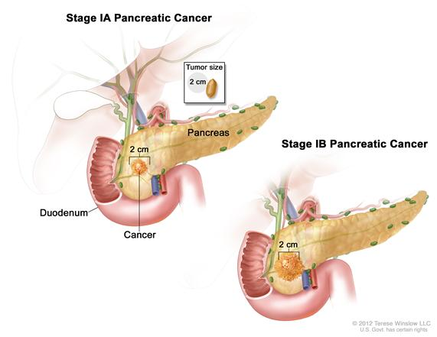
Stage I

Slide 14
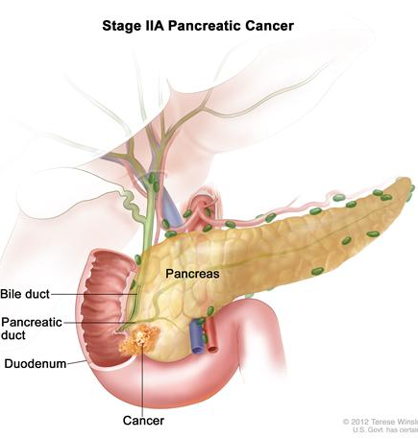
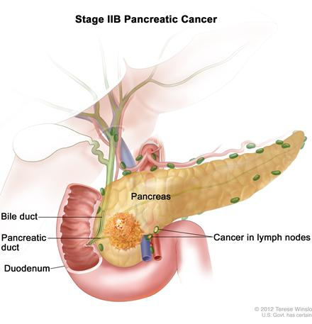
Stage II

Slide 15
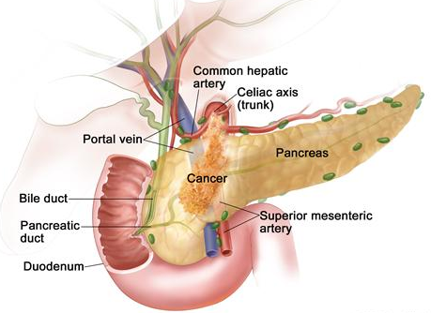
Stage III

Slide 16
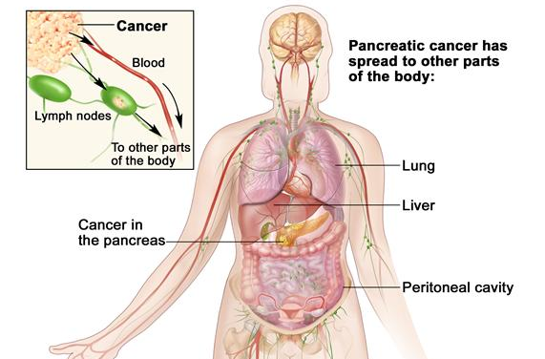
Stage IV

Slide 17
Other terms:
Another factor in staging pancreatic cancers is the extent of resection:
    From R0, where all visible and microscopic tumor was removed…
    To R2, where some visible tumor could not be removed
Some doctors use a simpler staging system, dividing cancers into groups based on likelihood of surgical removal:
    Resectable
    Locally advanced (or unresectable)
    Metastatic

Slide 18
Treatment options
Surgery
Palliative surgery
Radiation
Chemotherapy
Biologic therapy
Ablative techniques

Slide 19
References
http://pathology.jhu.edu/pc/BasicOverview1.php
http://www.cancer.org/cancer/pancreaticcancer/index
http://www.cancer.gov/cancertopics/types/pancreatic
http://www.mayoclinic.com/health/pancreatic-cancer/DS00357
http://www.cancer.gov/cancertopics/factsheet/detection/tumor-grade
http://www.cancer.gov/cancertopics/pdq/treatment/pancreatic/Patient/page2
http://www.upmccancercenter.com/pdq_xml/cancer.cfm?id=105

