Slide 1
Prostate Cancer
Treatments
By: Ishan Parikh

Slide 2
Symptoms
Be on the look out for…
  “stop-and-go” flow of urine
  Sudden urges to urinate
  Frequent urination (esp. at nights)
  Trouble starting urination
  Trouble with emptying bladder completely
  Pain or burning while urinating
  Blood where it does not belong
  Ongoing pain in the back, hips, or pelvis
  General tiredness, fast heartbeat, dizziness, paleness

Slide 3
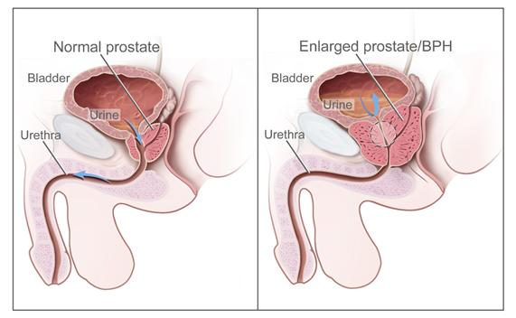
Why those symptoms?
You may have some prostate issues..
  BPH (Benign Prostatic Hyperplasia) vs Prostate Cancer
~1 in 5 US men, mainly older, will be diagnosed with prostate cancer

Slide 4
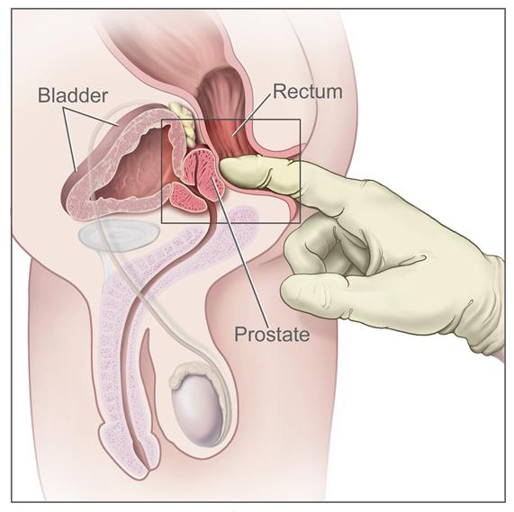
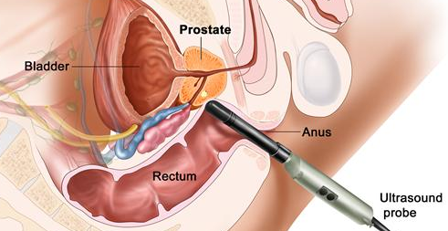
Tests for diagnosis
Digital Rectal Exam
PSA (Prostate-specific antigen) test
Transrectal ultrasound
Transrectal biopsy

Slide 5
Factors for prognosis
The chance of recovery depends on…
  State of the cancer (PSA level, Gleason score, tumor grade, and stage of cancer)
  Patient’s age
  Whether first diagnosis or recurrent
The treatment options depend on…
  Other health issues of patient
  Expected side effects of each treatment
  Past treatments influence new treatments
  The patients’ choice

Slide 6
Staging and Grading
Previously discussed how cancer is staged and graded… but what tests help in that process?
  Bone scan – checks if cancer cells are in the bone by sending radioactive material to collect abnormal cells
  MRI – using magnets and radio waves, makes a series of detailed pictures inside body
  CT (CAT scan) – uses X-rays to make detailed pictures of body from different angles
  Pelvic lymphadenectomy – remove lymph nodes to view tissue under microscope
  Seminal vesicle biopsy – views fluid under microscope to look for cancer cells

Slide 7
Treatment Overview
Current options | Stages
Watchful waiting, active surveillance | I, II, III, IV
Surgery | I, II, III, IV
Radiation therapy | I, II, III, IV
Chemotherapy | IV
Hormone therapy | II, III, IV
Biologic therapy – uses patient’s own immune system | IV
Bisphosphonate therapy – drug for bone metastasis | IV
Targeted therapy – drugs to target specific cells | IV
New Options (clinical trials) | Stages
Cryosurgery | I, II, III
High-intensity focused ultrasound | I, II
Proton beam radiation therapy | II, III

Slide 8
Treatment options
Watchful waiting – Closely monitoring patient condition without giving treatment until symptoms show
  -Test results positive, but no symptoms
Active Surveillance – Closely following condition without treatment unless there are changes in test results
  -Symptoms and test results positive, but very low risk

Slide 9
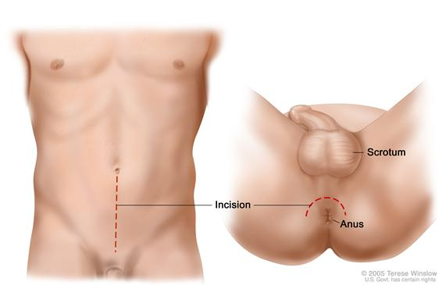
Surgeries
Retropubic prostatectomy – incision made in abdominal wall
Perineal prostatectomy – incision made between scrotum and anus

Slide 10
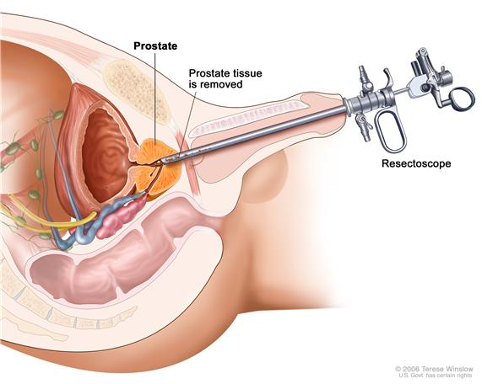
Surgeries (con’t)
Transurethral resection of the prostate (TURP) – helps in treating BPH by removing some tissue from prostate, but not all
  Holmium laser
  enucleation
Problems
  Impotence
  Leakage of urine
    (Incontinence)
  Shortening penis
  Inguinal hernia

Slide 11
Radiation
External – makes a 3-D picture of tumor and beams are shaped to fit the tumor
Internal (Brachytherapy) – radioactive substance is placed near cancer. (strontium-89)
  Use ultrasound + CT to accurately place seeds
Problems
  Impotence and urinary problems
  Increased risk of bladder or rectal cancer

Slide 12
Hormone therapy
Many hormonal changes can help reduce size of prostate
  Main goal is to stop making testosterone
Problems
  Hot flashes
  Impaired sexual function and loss of desire
  Weakened bones
  Other common side effects – diarrhea, nausea, itching

Slide 13
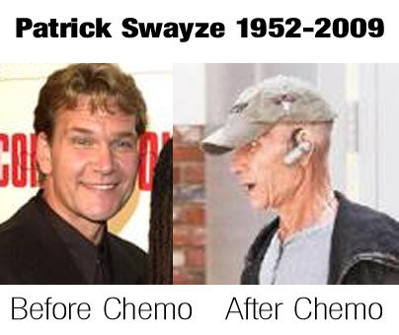
Chemotherapy
Widely used cancer treatment, but mostly for metastasized cancers
Kills all newly growing cells in body
  -including bone marrow, lining of mouth and intestines, and hair follicles
Problems
  Many side effects – nausea, vomiting, diarrhea, lowered resistance to infection, easily bruised, fatigue
  Lowers white and red blood cells
  Most side-effects are short term

Slide 14
Bisphosphonate + Targeted + Biological therapies
These are not fix-all cures, they are helpers
Bisphosphonate - drugs help to reduce bone disease and pain when cancer spread to bones. Inhibit bone cell type that causes bone break down
  Treats osteoporesis
Targeted therapy –drugs that find and attack certain cells without harming others
  Hormone therapy is an example
Biologic therapy – uses own immune system to make more cells in a laboratory

Slide 15
Targeted Therapy
Signal A > Hormone X
Hormone Y > Hormone X
If altering hormone Y does not work, then targeted therapies will alter signal A

Slide 16
Clinical trials
Cryosurgery – freezes and destroys cancer cells by using special instrument. Ultrasound is used to find area to be treated
High-intensity focused ultrasound – uses very high energy sound waves to try and destroy cancer cells. The cancer cells heat up and become destroyed
Proton beam radiation – uses high energy external radiation in streams of protons. Currently being studied

Slide 17
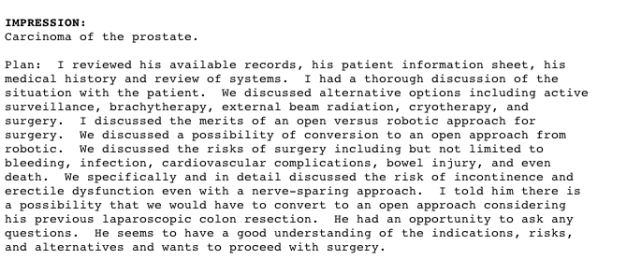
For more information….
Visit https://www.cancer.gov
http://www.youtube.com/watch?v=Xus8nrth7eM

