Slide 1
Cancer Staging & Grading
Staff Training Meetings
Grace Ordung, Stephanie Shelton, Linda Sircy, Brittney Fain, Alle Crider, Kelsey Shaffer

Slide 2
Explanation
Some staff were required to attend three training meetings to develop their understanding of cancer staging & grading. They were then asked to research and present on the follow topics:
  Current Vanderbilt clinical trial
  Biomarkers & prognostic indicators
  Neoadjuvant vs. Adjuvant
  Prostate vs. Ovarian staging
  Normal vs. Cancer images
  2 different cancers (staging, grading, treatments, symptoms, etc.)

Slide 3
Vanderbilt Clinical Trials
Clinical Trial: VICCGI1405
  Drugs used – nabpaclitaxel in combination with gemcitabine
  Cancer type – Pancreatic
  Objective – to compare disease-free survival (DFS) between subjects given nabpaclitaxel in combination with gemcitabine and subjects given gemicitabine alone
Clinical Trial: VICCGI13101
  Drugs used – FOLFOX-bevacizumab
  Cancer type – Colorectal
  Objective – compare patients given FOLFOX with high doses of vitamin D to patients given FOLFOX and standard doses of vitamin D

Slide 4
Clinical Trial: VICCNEU1404
  Drugs used – Nivolumab, Ipilimumab, Bevacizumab
  Cancer type – Recurrent Glioblastoma
  Objective – to compare the safety of nivolumab in combination with ipilimumab, to compare the survival of nivolumab patients versus bevacizumab and nivolumab in combo with ipilimumab versus bevacizumab
Clinical Trial: I 131 MIBG
  Drugs used – 131-MIBG/Iobenguane Sulfate
  Cancer type – neuroblastoma, pheochromocytoma or paraganglioma
  Objective – to provide palliative therapy with MIBG and gain more info about acute and late toxicity of 131I-MIBG

Slide 5
Clinical Trial: RO5185426, PLX4032
  Drugs used – Vemurafenib, Cetuximab
  Cancer type – BRAF mutation cancers
  Objective – to evaluate the efficacy of vemurafenib in patients with cancers harboring BRAF V600 mutations.
Clinical Trial: VICCMEL0287
  Disease site - Melanoma
  Objective – to characterize the markers in the steps in melanoma progression
  Want a better understanding of the genes involved to improve cancer prevention and therapy

Slide 6
Biomarkers & Prognostic Indicators
Biomarkers:
  2 major types:
    Biomarkers of exposure
    Biomarkers of disease
  9 approved protein biomarkers for cancer by FDA
    CML
    RT-PCR
    mRNA
    CTCs
    miRNAs
    KRAS
    BRAF
    PSA
    CA-125
Prognostic Indicators:
  Cancer-specific survival
  Relative survival
  Overall survival
  Disease-free survival
Proteomics – the study of protein structure, function and patterns of expression

Slide 7
Cancer Biomarkers
  Lung
    EGFR. KRAS, EM4-ALK
  Prostate
    PSA
  Gastric
    KIT
  Pancreatic
    CA 19-9
  Ovarian
    CA-125
  Melanoma
    LDH, BRAF, S-100
  Chronic Myeloid Leukemia (CML)
    BCR-ABL
  Colorectal Cancer
    CEA, KRAS, MMR, mRNA
  Liver
    AFP
  Multiple Myeloma
    Β-2-microglobulin
  Testicular
    AFP, hCG, LDH
  Thyroid
    Thyroglobulin
  Breast
    ER/PR, HER2, CA 15-3, CA 27.29, CEA, uPA, PAI-1

Slide 8
Staging Systems
TNM – most common system
  T – primary tumor
  N – spread to lymph nodes
  M – metastasis
FIGO – gynecological cancers
  Same factors as TNM
  Stage O does not exist
CIN – cervical intraepithelial neoplasia
  Usually caused by HPV
  Staged in grades (I-III)
WHO – central nervous system
  Histological features of tumor
Dukes – Colon cancer
  Similar to TNM
  A-D to classify tumor spread
  B & C divides further
Ann Arbor – lymphomas
  Uses roman numerals I-IV and “E” and “S”
Cotswold – lymphoma
  Modifications to Ann Arbor
  Letter “X” – bulky disease
  # of anatomic regions involved
  Stage III – 2 separate designations of nodal involvement

Slide 9
Neoadjuvant vs. Adjuvant
Therapy given before the primary therapy, which is usually resection
Common cancers:
  Breast
  Bladder
  Lung
  Colon
  Brain
Can affect staging of tumor, if tumor shrinks from therapy
Types of therapies:
  Chemo
  Radiation
  Hormone therapy
Therapy given after resection to lower the risk that cancer will come back
Common cancer:
  Prostate
Usually used when patient is at higher risk of recurrence
Types of therapies:
  Chemo
  Hormone therapy
  Radiation
  Immunotherapy
  Targeted therapy

Slide 10
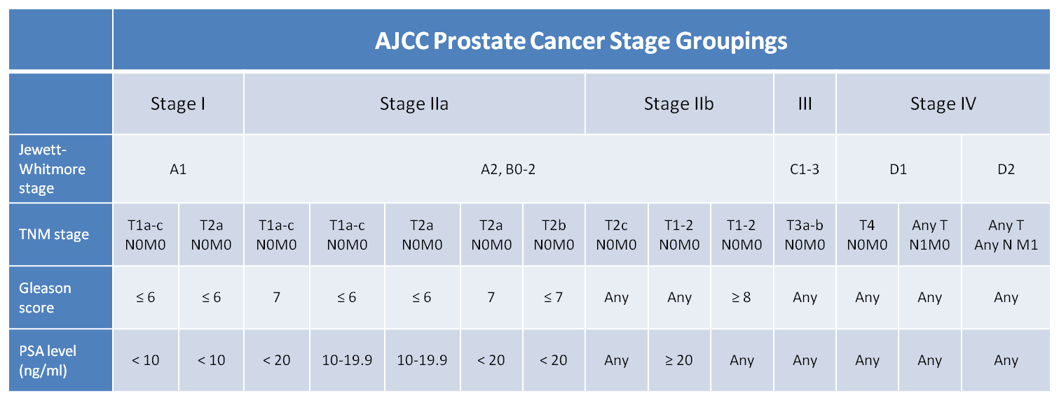
Prostate Cancer staging
Gleason Score

Slide 11
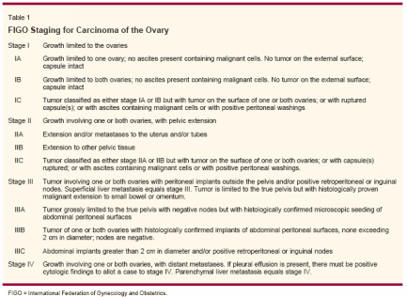
Ovarian Cancer staging
FIGO

Slide 12
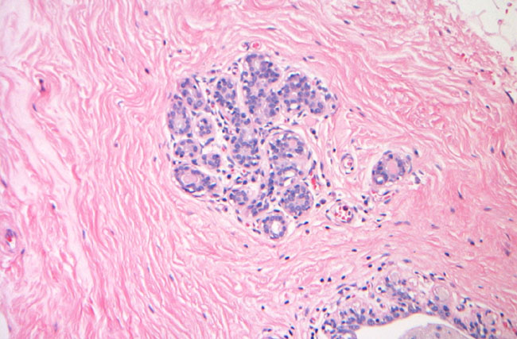
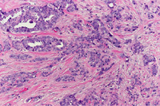
Normal vs. Cancer
Breast normal cells
IDC cells

Slide 13
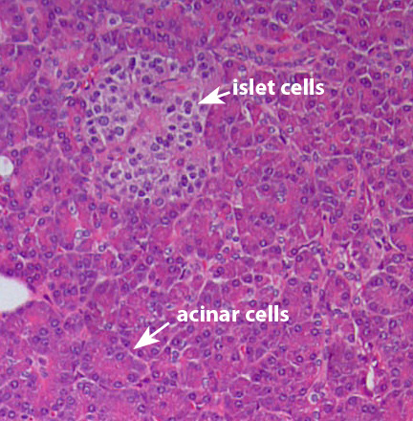
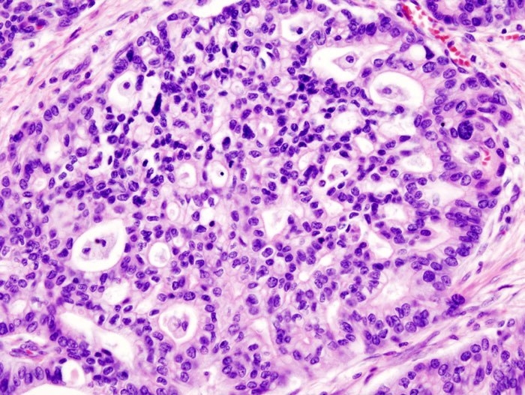
Normal Pancreas
Pancreatic Adenocarcinoma

Slide 14
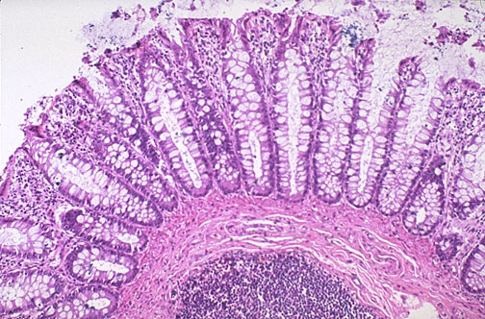
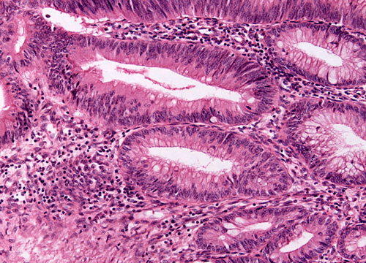
Normal Colon
Colon Adenocarcinoma

Slide 15
Soft Tissue Sarcoma
Adult
Most common in head, neck, arms, legs, trunk and abdomen
  Muscles, tendons, fat, blood/lymph vessels, nerves, tissue around joints
Survival rates:
  83% - localized
  54% - regional stage
  16% - distant spread
Survival is worse when sarcoma develops other limbs
  5-year survival for retroperitoneal sarcomas – 40% to 60%
Treatments:
  Surgery
    Most common
    Removal of sarcoma, whole limb
  Radiation
    External beam or brachytherapy
  Chemo
    Most common: ifosfamide (Ifex®) and doxorubicin (Adriamycin®)
  Targeted therapy
    Pazopanib (Votrient®)
      Only therapy drug approved for soft tissue sarcomas

Slide 16
Liver Cancer
Types:
  Hepatocellular carcinoma (most common)
  Cholangiocarcinoma
5-year survival rates:
  Over 50% - Small, resectable tumors
  60% to 70% - with liver transplant
  All stages is about 15%
Sorafenib has extended survival an average of 3 months
Treatments:
  Surgery
    Partial hepatectomy
    Liver transplant
  Ablation therapy
    Removes or destroys tissue
  Tumor embolization
    Substances used to block/decrease blood flow through hepatic artery to tumor
      TAE
      TACE
  Radiation
    3-D conformal, stereotactic, proton-beam
  Targeted therapy
    Sorafenib (Nexavar®)
  Chemo
    Most effective drugs are doxorubicin, 5-fluorouracil, floxuridine (FUDR), mitomycin C and cisplatin
    Liver cancer resists most chemo drugs

Slide 17
Breast Cancer
Clinical staging
  Physical exam, imaging, pathologic exam of the breast
Pathological staging
  Includes surgery
Types of cancer:
  Ductal carcinoma in situ, Lobular carcinoma in situ, IDC, invasive lobular carcinoma, inflammatory breast cancer, triple negative, paget’s disease, phyllodes, angiosarcoma, male breast cancer
5-year survival rates:
  Stage 0 – 100%
  Stage I – 100%
  Stage II – 93%
  Stage III – 72%
  Stage IV – 22%
Treatments:
  Surgery
    Lumpectomy, partial or total mastectomy, modified radical mastectomy
  Sentinel lymph node biopsy followed by surgery
  Radiation
    Done is almost every case
  Chemo
    Over 60 different drugs approved
  Hormone Therapy
    Tamoxifen, Aromatase
  Targeted therapy
  Clinical Trials
  Stem cell transplant

Slide 18
Melanoma
Diagnosing:
  Biopsy, Punch biopsy, Incisional and excisional biopsies, Lymph node biopsy, Imaging
Melanoma can spread very quickly
  Makes it hard to diagnose
Staging:
  TNM, Clinical, Pathological
  Based on thickness of tumor, ulcerated tumor, spread to lymph nodes, spread to other organs
5-year survival rate:
  Stage IA – 97%
  Stage IB – 92%
  Stage IIA – 81%
  Stage IIB – 70%
  Stage IIC – 53%
  Stage IIIA – 78%
  Stage IIIB – 59%
  Stage IIIC – 40%
  Stage IV – 15% to 20%
Treatments (by stage):
  Stage 0
    surgery
  Stage I
    surgery, sentinel lymph node biopsy
      Adjuvant immunotherapy if positive
  Stage II
    Surgery
    Sentinel lymph node biopsy
      Adjuvant immunotherapy if positive
  Stage III
    Surgery
    Adjuvant immunotherapy
    Radiation at times
    If multiple, follow different steps
  Stage IV
    Surgery
    Radiation
    Immunotherapy
    Chemo
    Targeted therapy

Slide 19
Prostate Cancer
Around 233,000 new cases in 2014 with 29,000 deaths
  Survival rates:
    Local – 100%
    Regional – 100%
    Distant – 28%
Treatment:
  Stage I & II is usually radical prostatectomy
  External-beam radiation therapy
  Internal radiation therapy
  TURP
  Hormone therapy
  Cryosurgery

Slide 20
Bladder Cancer
Over 70,000 new case in 2014 and 15,000 deaths
Survival rates:
  Stage 0 – 98%
  Stage I – 88%
  Stage II – 63%
  Stage III – 46%
  Stage IV – 15%
Treatment:
  TUR
  BCG
  Radical & partial cystectomy
  Reconstructive surgery
    Incontinent diversion
    Continent diversion
    Neobladder

Slide 21
Rectal Cancer
Types:
  Adenocarcinoma, carcinoid tumors, GISTs, Lymphomas, Sarcomas
Survival rates:
  Stage I – 74%
  Stage IIA – 65%
  Stage IIB – 52%
  Stage IIC – 32%
  Stage IIIA – 74%
  Stage IIIB – 45%
  Stage IIIC – 33%
  Stage IV – 6%
Treatments:
  Surgery
  Radiation
    External and internal
  Chemo
    Capecitabine- (Xeloda FDA approved)
  Targeted therapy
    Adjuvant

Slide 22
Neuroblastoma
Most common in and around adrenal glands
Most commonly affects children age 5 and younger
Develops from immature nerve cells
Sporadic and Familial
5-year survival rate by age:
  Younger than 1 – 90%
  1to 4 years – 68%
  5 to 9 years – 52%
  10 to 14 years – 66%
Staging:
  INSS
  INRGSS
Treatments:
  Observation
  Surgery
  Radiation
    External and internal
  Chemo
    Systemic and regional
  High-dose chemo and radiation therapy with stem cell rescue

Slide 23
Pancreatic Cancer
Staging:
  TNM
5-year survival rates:
  localized – 25.8%
  Regional – 9.9%
  Distant – 2.3%
  Unstagged – 4.4%
Treatments:
  Surgery
    Whipple
    Total pancreatectomy
    Distal pancreatectomy
  Radiation
  Chemo/radiation
  Chemo
  Targeted therapy

Slide 24
Bone Cancer
An uncommon cancer that begins in a bone
  Most commonly affects the long bones of the arms and legs
Types:
  Osteoscarcoma
  Chondrosarcoma
  Ewing Sarcoma
Staging:
  TNM
  TX, T0-T3
  N0, N1
  M0, M1. M1a, M1b
Grade:
  G1-G2 – low grade
  G3-G4 – high grade
Treatment:
  Surgery
  Radiation
  Chemo
  Targeted therapy
5-year survival rate:
  66.6%
Bone cancer represents 0.2% of all new cancer cases in the U.S.

Slide 25
Anal Cancer
An uncommon malignancy that starts in the anus.
Begins when normal cells in or on the anus change and grow uncontrollably, forming a tumor mass.
Staging:
  Stage 0
  Stage I
  Stage II
  Stage IIIA
  Stage IIIB
  Stage IV
Treatment:
  Surgery
  Radiation
  Chemo
  Chemoradiation
    Best approach
5-year survival rate:
  Localized – 79.7%
  Regional – 58.1%
  Distant – 32%
  Unstagged – 60.4%
Anal cancer represents 0.4% of all new cancer cases in the U.S.

Slide 26
Thank you for reading!
If you have any questions or comments, please visit our contact page to obtain email addresses and phone numbers of staff.

